Slide 1

Detection of sexual harassment In Workplace
Ai-Arena 2.0 Powered by Mercer | mettl

Slide 2
Agenda
Introduction
Problem Statement
Metrics
Solution
Working
Model Architecture
Primary Goals
Existing solution
Key Uniqueness
Business Model
Scalability
Pipeline
Proof Of Concept
20XX
Notes:
2

Slide 3
INTRODUCTION
Addressing workplace sexual harassment as a pressing social issue has led to increased focus. Creating a safe, inclusive environment for employees is crucial and legally mandated.
However, recognizing and tackling harassment instances can be complex due to victim hesitation prompted by fear or stigma. We aim to develop a CNN-based model to detect workplace harassment, differentiating it accurately from normal behavior's in videos.
Aiming to mitigate workplace harassment, we highlight the importance of a secure and respectful work environment. Legal obligations underscore the need for inclusive workplaces, but identifying and addressing harassment remains challenging. Victims often avoid reporting due to fear and stigma.
Our solution leverages a CNN-based model to effectively detect harassment in videos, contributing to a safer workplace and fostering a culture of inclusivity.

Slide 4
DATASET
Also there was not a single detection project/solution in the web that you can find for addressing this issue So we wanted to make a solution to this., and due to this we also had to make our own image and video dataset as there is no existing dataset online.
So, we had to create the dataset ourselves, which was a tedious process.
it has 2 folder which are :
1) yes - having 1000 pictures(Harassment)
2) no - having 1000 pictures(Healthy work environment)
DATASET LINK : DATASET

Slide 5
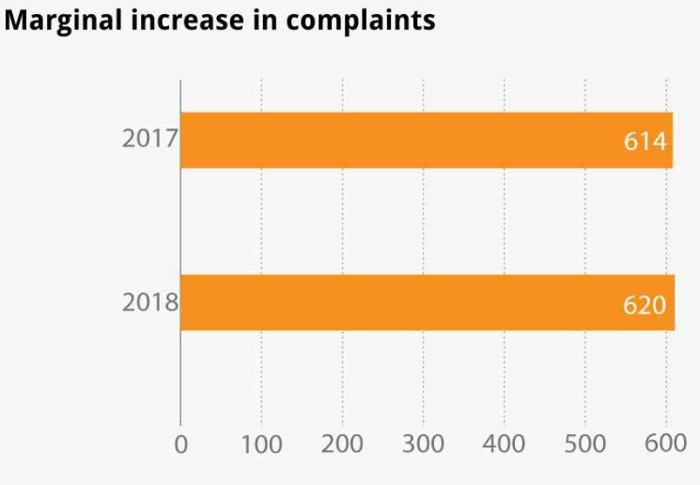
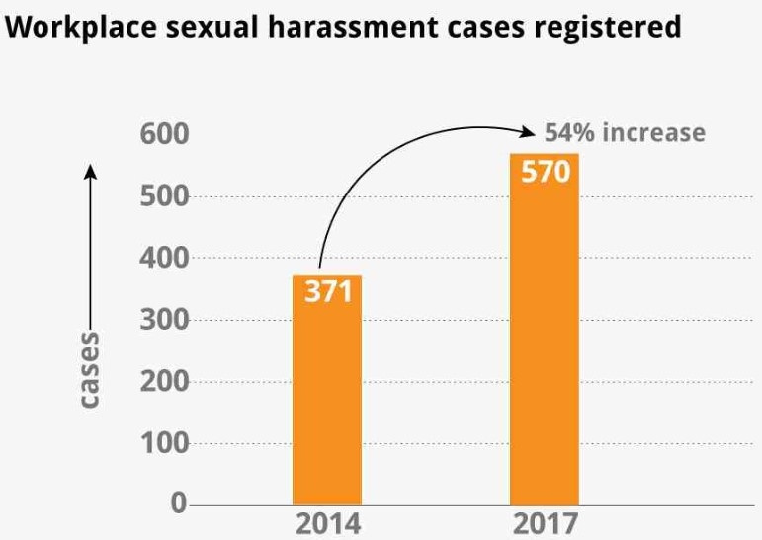
METRICS
63% of women did not file a complaint, and 79% of men kept issues to themselves.
Nearly 3 in 4 sexual harassment claims in the workplace go unreported.
75% of sexual harassment cases in the workplace are unreported.
95% of harassers go unpunished.
72% of victims were harassed by someone more senior in their workplace.
7 in 10 people believe their companies do not take sexual harassment seriously.
5

Slide 6
PROBLEM STATEMENT
Why sexual harassment at work place
Detection of sexual harassment
Workplace sexual harassment, a pervasive societal issue, challenges individuals and organizations alike. In recent decades, it has emerged as a critical concern jeopardizing employee safety and well-being.
Ranging from subtle gender-based discrimination to overt assault, this issue emotionally and physically distress victims, harming productivity and satisfaction. Effective detection is crucial.
Various efforts, including legislation, education, and campaigns, have fallen short in preventing workplace harassment. It remains prevalent despite attempts to create safer environments, particularly affecting female employees with reported cases.
This underscores the need for innovative technological solutions that can identify and curb sexual harassment in real time, filling the gap left by traditional methods.

Slide 7
SOLUTION
Our solution aims to address the issue of sexual harassment in the
workplace by utilizing deep learning techniques, particularly
Convolutional Neural Networks (CNNs).
The solution's technical side entails video preprocessing, CNN architecture construction, training with loss functions, and metric-based evaluation. Transfer learning could enhance outcomes.
The iterative process involves experimentation, optimizing performance, refining architecture, and utilizing pre-trained models for accurate workplace sexual harassment detection.
We will follow an 80:20 split, where 80% of the images will be used for training our model, and the remaining 20% will be reserved for testing the model.
To further enhance the accuracy of the detection system, we have implemented Transfer Learning techniques by leveraging pre-trained models such as VGG16, Xception, and others.
These models have been trained on large-scale datasets and come with high accuracy levels.

Slide 8
WORKING
Data preprocessing
Data preprocessing converts videos to frames and resizes them. CNN layers form the architecture, detecting patterns like edges, textures, and shapes via spatial convolution—separable convolutions lower parameters. Batch normalization normalizes outputs, reducing covariate shifts. These layers combine features, utilizing a sigmoid activation function for binary classification (harassment or non-harassment).
BUILD AND TRAIN THE MODEL
The model is trained using input frames and backpropagation to update weights and minimize loss. Validation data tracks performance during training. The final model is evaluated on unseen test data using accuracy, precision, recall, and F1-score metrics. Pre-trained models like VGG16, DenseNet201, and Xception are explored, using transfer learning to improve performance.
ACCURACY AND LOSS
The solution's effectiveness is measured in terms of accuracy, precision, recall and F1-score, using evaluation metrics.

Slide 9
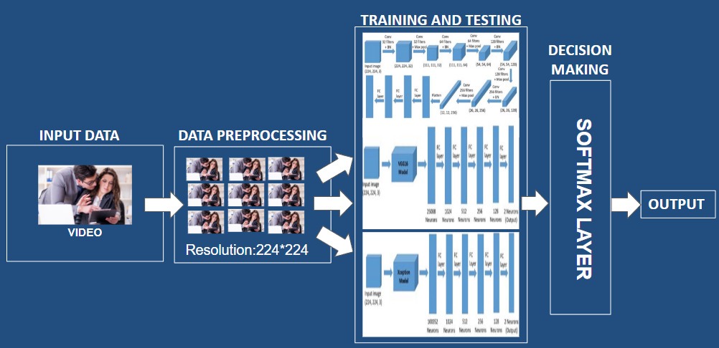
MODEL ARCHITECTURE

Slide 10
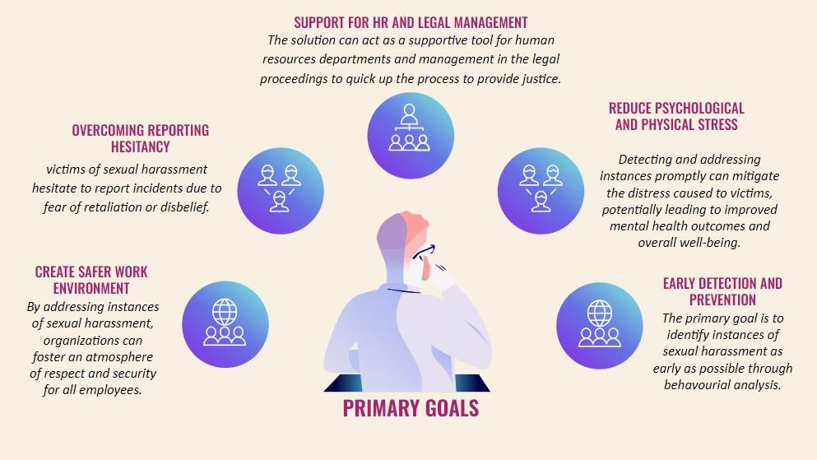

Slide 11
EXISTING SOLUTION
SEXUAL HARASSMENT POLICIES :
Organizations have established clear and comprehensive sexual harassment policies that outline prohibited behavior's, reporting procedures, and consequences for violators. These policies are often communicated to all employees and enforced rigorously.
SOCIAL MEDIA AND #MeToo MOVEMENTS :
The rise of social media has allowed victims to share their experiences, leading to the #MeToo movement. This movement has contributed to a broader cultural shift and increased public awareness about sexual harassment.
AWARENESS CAMPAIGNS :
Public awareness campaigns and initiatives within organizations and the broader community highlight the importance of preventing sexual harassment and promoting respectful behavior.
LEGAL FRAMEWORKS AND COMPLIANCE :
Governments have established laws and regulations that define sexual harassment and mandate appropriate action against offenders. Employers are required to comply with these legal requirements.
EMPLOYEE TRAINING AND WORKSHOPS :
Many companies provide mandatory training sessions and workshops to educate employees about sexual harassment, its forms, and the importance of creating a respectful workplace culture. These programs aim to raise awareness and empower individuals to recognize and report harassment.

Slide 12
KEY UNIQUENESS
DATASET :
We have created our own dataset for this projects as there were no existing dataset
yet, The dataset contains a combination of frames exported from videos and images collected from various sources put together.
EARLY DETECTION SYSTEM :
The project has the potential to not only identify ongoing harassment incidents but also to provide insights that can help organizations proactively address harassment and create safer work environments.
REAL TIME MONITORING :
By using live camera feeds, the project has the potential to provide real-time monitoring of workplace environments. This allows for immediate response and intervention if harassment incidents occur.
AUTOMATED INCIDENT REPORTING :
This project's automated approach can significantly speed up the detection process and reduce the reliance on manual intervention.
UNBIASED CONSISTENT AND OBJECTIVE ANALYSIS :
Automated AI systems offer consistent and objective analysis, reducing potential bias that might occur in human judgment. This ensures a fair assessment of incidents.

Slide 13
BUSINESS MODEL
SUBSCRIPTION MODEL :
Offer a subscription-based service to companies and organizations
API ACCESS :
Provide an API and charge a fee based on the API usage.
DATA INSIGHTS SUBSCRIPTION :
Offer insights and analytics based on the collected data to help organizations understand harassment trends and take proactive measures.
FREEMIUM MODEL :
Offer a basic version of the system for free with limited features and usage. Organizations can then upgrade to a premium version with more advanced features and capabilities.
WHITE LABEL SOLUTION :
Develop a white-label version of the system that other companies can customize and rebrand for their own use.

Slide 14
BUSINESS MODEL
SWOT ANALYSIS
STRENGTHS | WEAKNESSES
UNIQUE AND INNOVATIVE SOLUTION EASY ADOPTIBILITY EVIDENCE GENERATION SATISFIES THE HIGH DEMAND EASY TO INSTALL & IMPLEMENT ON LARGE SCALE | DATA PRIVACY CONCERNS Gathering and processing sensitive employee data raises concerns about data privacy and security. 2. CULTURAL SENSITIVITY Different cultures have varying definitions of harassment. The system might need customization for different workplaces.
OPPORTUNITIES | THREATS
GROWING AWARENESS LEGISLATIVE CHANGES LEADS TO HIGH DEMAND CUSTOMIZATION BASED ON INDUSTRY SPECIFIC NEEDS INTEGRATION WITH EXISTING HR AND REPORTING SYSTEMS | ETHICAL CONSIDERATIONS Automated monitoring might raise ethical concerns among employees about constant surveillance. 2. LEGAL CHALLENGES Legal challenges related to data privacy, false accusations, and accountability could pose risks.

Slide 15
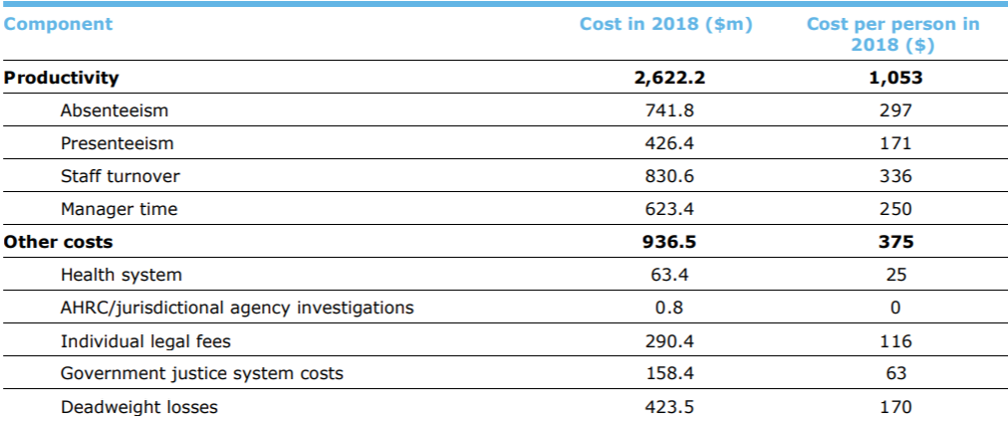
BUSINESS MODEL
MARKET SIZE
TYPE
APPLICATION
Hardware Devices
Software Systems
CCTV Cameras
Smart Phones and Any Camera Device
Workplace sexual harassment costs an average of $2.6 billion in lost productivity or $1,053 per victim.
The Market Size is huge Because :
ZERO COMPETITION
There has been no research or active solution for this problem.
GEOGRAPHIC SCOPE
This is a Global issue and not regional specific.
HIGH WILLINGNESS OF ADOPTIBILITY
The loss caused due to this problem is huge and increasing, so it's adopted quickly.

Slide 16
SCALABILTY
CORPORATE SOCIAL RESPONSIBILITY(CSR) INITIATIVES :
Companies concerned about sexual harassment issues may be willing to invest in supporting to build a detection project as part of their CSR initiatives. Companies could provide funding, resources, or technical expertise to the project, enhancing their brand image and fulfilling their social responsibility objectives.
COLLABORATION AND INTEGRATION :
Given the social impact nature of a sexual harassment detection project, securing grants or donations from NGOs, philanthropic organizations, governmental agencies, or corporate social responsibility programs can be a sustainable business model. These funds can support the project's research, development, data collection efforts, and operational costs.
HARDWARE AND SOFTWARE INFRASTRUCTURE :
The project's scalability requires consideration of the underlying hardware and software. This involves optimizing code, utilizing parallel processing, and potentially using cloud resources to handle increased demands.
16

Slide 17
pipeline
EARLY WARNING SYSTEM
CULTURAL NORMALISATION
ENHANCING SOCIETAL IMPACT
Through behavioural analysis it predicts non-desirable behavioural patterns and warns potential threats.
Adapt the model to different cultural contexts for multinational organizations.
Integrating advanced predictive machine learning models with a focus on addressing and resolving societal challenges.
EMOTION AND INTENT ANALYSIS
REALTIME ADAPTIVE LEARNING
CONTEXTUAL DOMAIN EXPANSION AND ADAPTION
Periodically re-train the model with new data to adapt to evolving and emerging harassment tactics.
Analyzes emotions and intentions in conversations, identifying subtle signs of manipulation, gaslighting, and emotional abuse.
Expanding a model's capabilities to detect sexual harassment in various places and environments.

Slide 18


Proof of concept
STREAMLIT
Stream lit Host Link :Streamlit (harassment-detection.streamlit.app)
Dataset for testing : Dataset
20XX

Slide 19
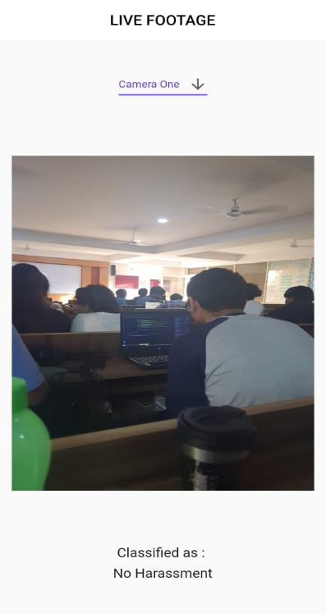



Proof of concept
FLUTTER
PYTHON & JAVA
INPUT : IMAGE

Slide 20
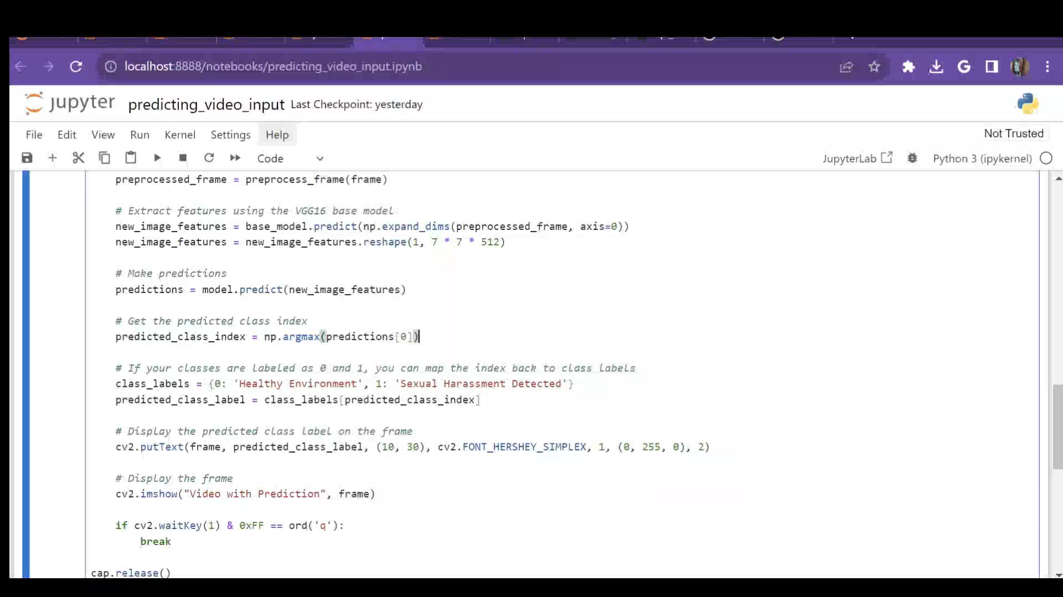
Proof of concept
INPUT : VIDEO

Slide 21
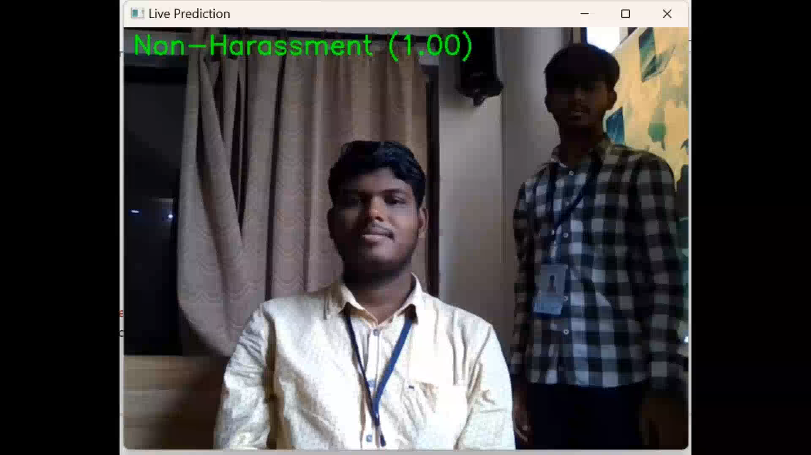
Proof of concept
INPUT : LIVE VIDEO(CCTV)

Slide 22
FUNDING
We are open to teaming up with investors. We'd love to hear from you if we have any of them here. Let's connect and discuss how we can work together to make this a big launch.
Email : geekssaga@gmail.com

Slide 23

THANK YOU
SEXUAL HARASSMENT DETECTION

